Slide 1
Feature Free Method for Detecting the Phishing Websites
Presented by:
920119104003 Buvaneshwari.K
920119104015 Sneha.R
920119104017 Sowmya.P
920119104020 Viji.T
Guided by:
K.Saravanaselvi.ME
Assistant professor/IT

Slide 2
ABSTRACT
Phishers try to deceive their victims by social engineering or creating mock up websites to steal information such as account ID, username, password from individuals and organizations.
This information is typically used to make an illegal economic profit (e.g., by online banking transactions, purchase of goods using stolen credentials, etc.). -
Persons with criminal mind have found a way of stealing personal information without actually meeting them and with the least risk of being caught. It is called Phishing.
Hence it is essential to know about phishing. Although many methods have been proposed to detect phishing websites, Phishers have evolved their methods to escape from these detection methods.
In this paper, we compared the results of multiple machine learning methods for predicating phishing website.

Slide 3
OBJECTIVE
To find the results effectively and quickly.
To enhance the performance of the dynamic prediction.
To increase the accuracy of the Classification results.
Proposed a web-based system which provides a security
To holds previous information and characteristics of websites

Slide 4
Literature Survey

Slide 5
Title | Year | Author | Methodology
STUDY ON PHISHING ATTACKS AND ANTIPHISHING TOOLS | 2016 | Dr.Radha Damodaram | Phishing is the attempt to acquire sensitive information such as usernames, passwords, and credit card details (and sometimes, indirectly, money), often for malicious International Research Journal of Engineering and Technology reasons, by masquerading as a trustworthy entity in an electronic communication. Now days it has become very serious. There are many techniques to solve these problems. But people may don’t aware of the seriousness of phishing. information and credentials.

Slide 6
Title | Year | Author | Methodology
Counteracting Phishing Page Polymorphism: An Image Layout Analysis Approach | 2012 | Ieng-Fat Lam, Wei-Cheng Xiao, Szu-Chi Wang, and Kuan-Ta Chen | we have proposed a polymorphic phishing page detection mechanism based on layout similarity analysis. To cope with polymorphic counterattacks from phishers, we apply image processing techniques and analyze the layout of the page rather than the text content or the HTML codes. The image-based phishing detection mechanism is more robust than the HTML-based approach because it is more adaptable to phishing page polymorphism. In our experiments, 6, 750 phishing pages and 312 authentic pages were analysed and evaluated.

Slide 7
EXISTING SYSTEM
The Existing system uses Normal Compression Distance to find similarity between websites, that doesn’t classify the data accurately.
It decreases the accuracy of the data classification and prediction.
For increasing the accuracy of the data classification and prediction the proposed system is introduced.
Classification using large volume of data decreases the accuracy of the classification.
DISADVANTAGES
Theoretical Limits.
Loss of Information.
Incorrect Classification Results.

Slide 8
ADVANTAGES
PROPOSED SYSTEM
Also, we evaluate the Principal Component Analysis is an unsupervised learning algorithm that is used for the dimensionality reduction in machine learning. It is a statistical process that converts the observations of correlated features into a set of linearly uncorrelated features with the help of orthogonal transformation.
The singular value decomposition (SVD) provides another way to factorize a matrix, into singular vectors and singular values. The SVD is used widely both in the calculation of other matrix operations, such as matrix inverse, but also as a data reduction method in machine learning.
High performance.
Provide accurate prediction results.
Reduces the information Loss and the multiple estimates.

Slide 9

SYSTEM ARCHITECTURE
Select and View Dataset
Feature Extraction
Dataset
Classification
Data preprocess
Prediction
Splitting Dataset into Train and Test
Result Generation

Slide 10
FLOW DIAGRAM
Start
Select Dataset
View Data
Data Preprocessing
Classification
Missing Data Removal
Prediction
Splitting Dataset into Training and Test Dataset
Result Generation
Feature selection using chi-selector
Feature Extraction

Slide 11
CLASS DIAGRAM
DATASET
Select dataset ()
Import dataset ()
DATA PREPROCESSING
Missing data removal ()
Dataset Splitting Train and Test
FEATURE EXTRACTION
Feature selection using chi-selector
Feature Extraction
View dataset ()
RESULT GENERATION
Result Generation ()
CLASSIFICATION
Phishing Prediction ()
Prediction ()

Slide 12
SEQUENCE DIAGRAM
DATA SELECTION & VIEW
FEATURE EXTRACTION
PREPROCESSING
CLASSIFICATION
RESULT GENERATION
Select path
Data Preprocess
Feature selection using chi-selector
Import Dataset
Missing Data Removal
Classification
Splitting Dataset into Training and Test Data
Preview Data

Slide 13
MODULES
Data Selection and Loading
Data Preprocessing
Splitting Dataset into Train and Test Data
Feature Extraction
Classification
Prediction
Result Generation

Slide 14
SYSTEM REQUIREMENTS
Software Requirements
O/S : Windows 7.
Language : python.
IDE : Anaconda - Spyder

Slide 15
SYSTEM REQUIREMENTS
Hardware Requirements
System : Pentium IV 2.4 GHz
Hard Disk : 1000 GB
Monitor : 15 VGA color
Mouse : Logitech.
Keyboard : 110 keys enhanced
Ram : 4GB

Slide 16
DATA SELECTION AND LOADING
The data selection is the process of selecting the data predicting the phishing website attack.
In this project, the phishing dataset is used for predicting website attack.
The dataset which contains the information about the Index, Using IP, Long URL, ShortURL,Symbol@,Redirecting//,PrefixSuffix,SubDomains,HTTPS,DomainRegLen, Favicon,NonStdPort,HTTPSDomainURL,RequestURL,AnchorURL,LinksInScriptTags, ServerFormHandler,InfoEmail,AbnormalURL,WebsiteForwarding,StatusBarCust, DisableRightClick,UsingPopupWindow,IframeRedirection,AgeofDomain,DNSRecording,WebsiteTraffic,PageRank,GoogleIndex,LinksPointingToPage,StatsReport,class.

Slide 17
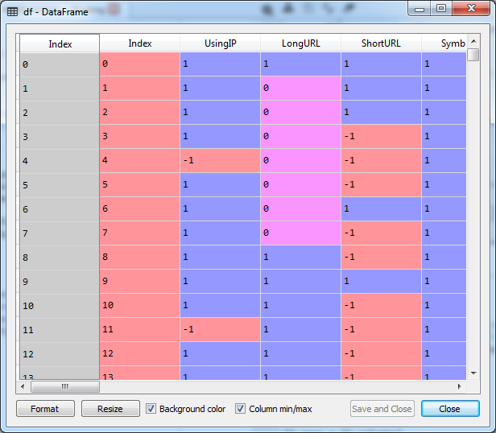

Slide 18
DATA PREPROCESSING
Data preprocessing is the process of removing the unwanted data from the dataset.
Missing data removal
Encoding Categorical data
Missing data removal: In this process, the null values such as missing values are removed using imputer library.
Encoding Categorical data: That categorical data is defined as variables with a finite set of label values. That most machine learning algorithms require numerical input and output variables. That an integer and one hot encoding is used to convert categorical data to integer data.

Slide 19
SPLITTING DATASET INTO TRAIN AND TEST DATA
Data splitting is the act of partitioning available data into. two portions, usually for cross- validatory purposes.
One. portion of the data is used to develop a predictive model. and the other to evaluate the model's performance.
Separating data into training and testing sets is an important part of evaluating data mining models.
Typically, when you separate a data set into a training set and testing set, most of the data is used for training, and a smaller portion of the data is used for testing.
Chi-square test is used for categorical features in a dataset. We calculate Chi-square between each feature and the target and select the desired number of features with best Chi-square scores. It determines if the association between two categorical variables of the sample would reflect their real association in the population.

Slide 20

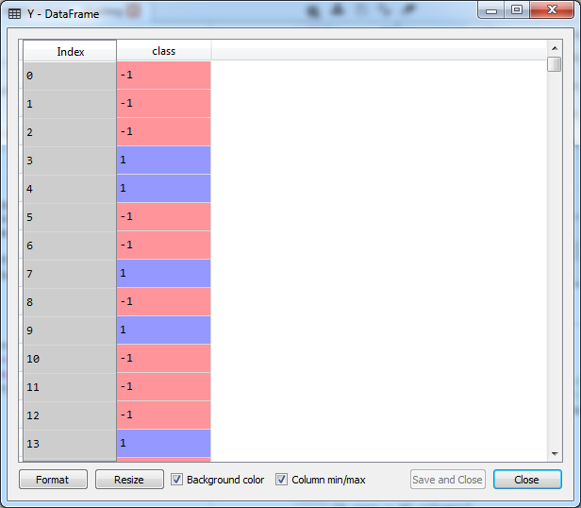

Slide 21
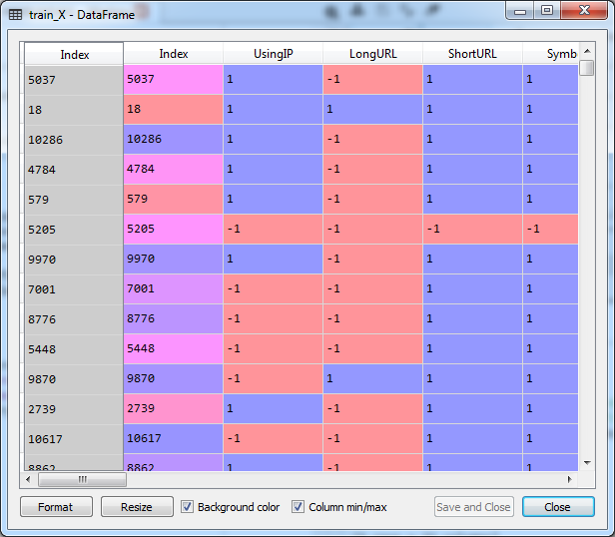
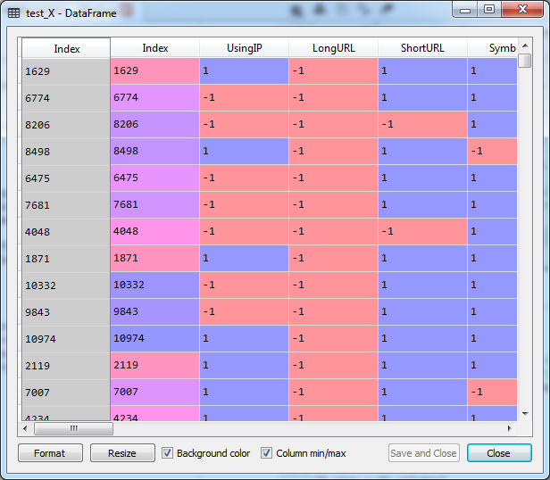

Slide 22
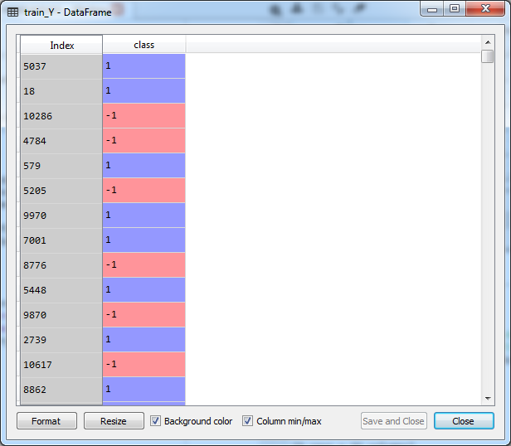
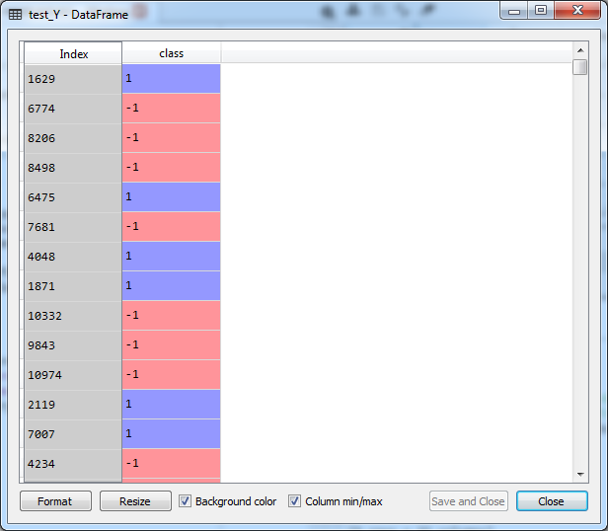

Slide 23
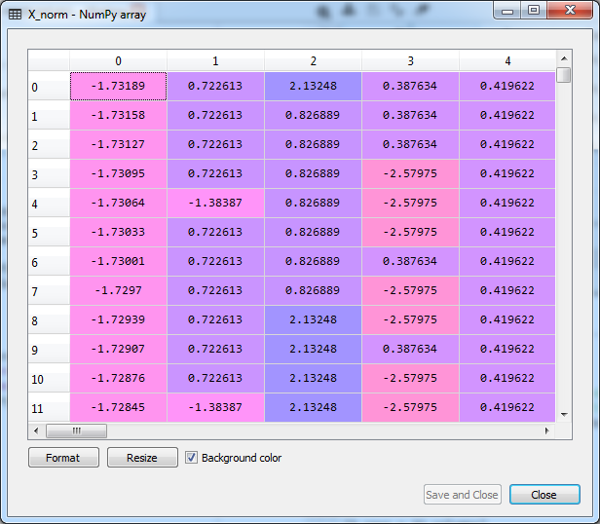

Slide 24
FEATURE EXTRACTION
Feature Scaling or Standardization: It is a step of Data Pre Processing which is applied to independent variables or features of data. It basically helps to normalise the data within a particular range. Sometimes, it also helps in speeding up the calculations in an algorithm.
Principal Component Analysis is an unsupervised learning algorithm that is used for the dimensionality reduction in machine learning. It is a statistical process that converts the observations of correlated features into a set of linearly uncorrelated features with the help of orthogonal transformation.
The singular value decomposition (SVD) provides another way to factorize a matrix, into singular vectors and singular values. The SVD is used widely both in the calculation of other matrix operations, such as matrix inverse, but also as a data reduction method in machine learning.

Slide 25
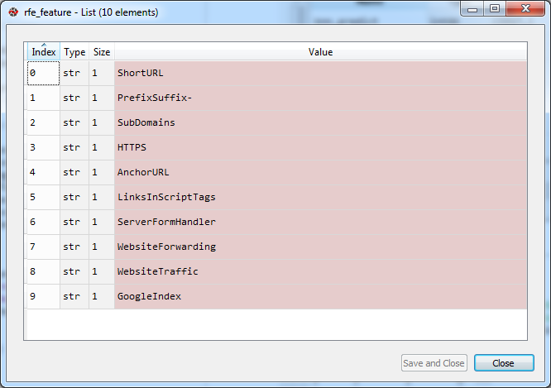
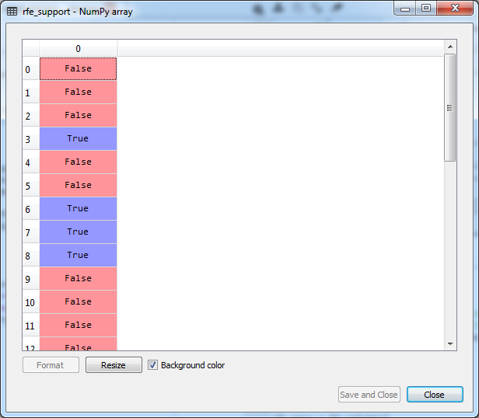

Slide 26
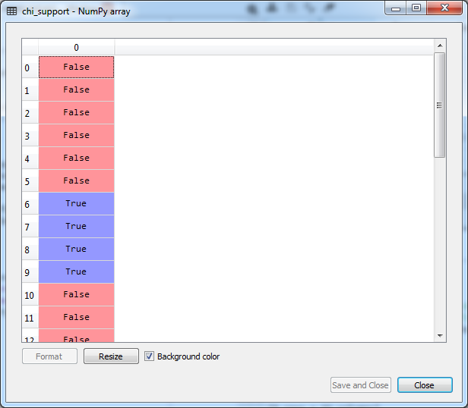
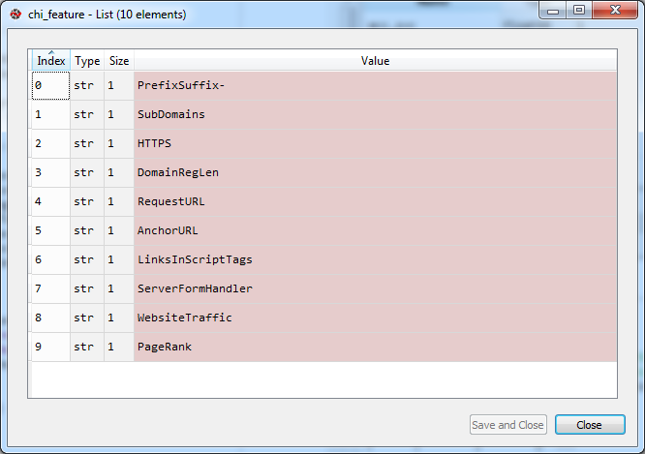

Slide 27
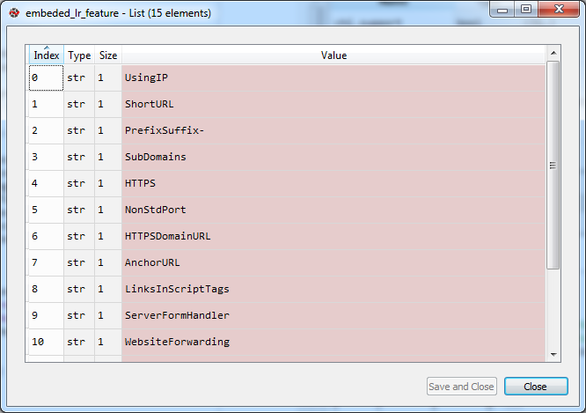
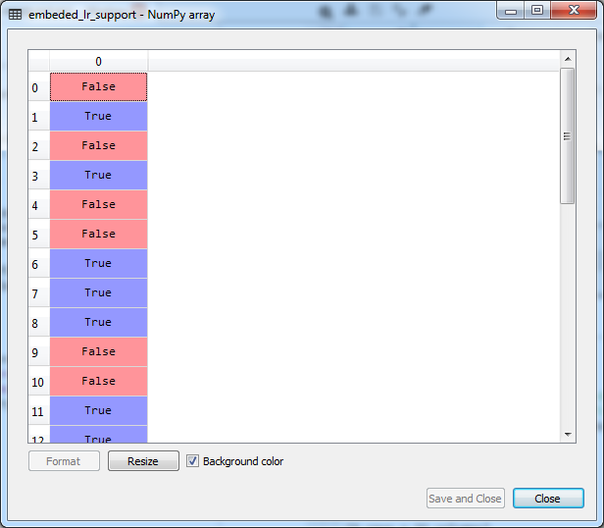

Slide 28
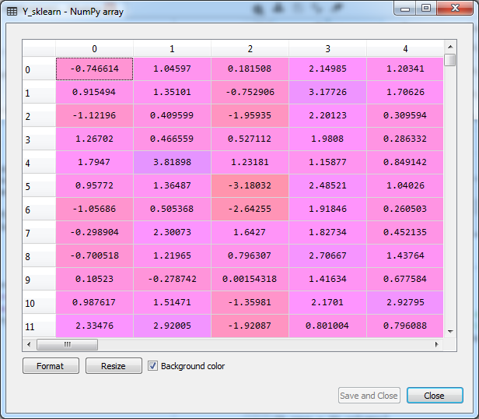
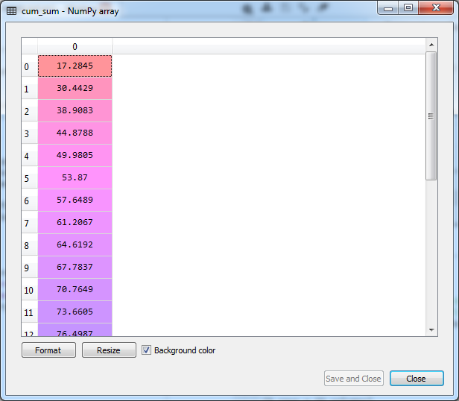

Slide 29
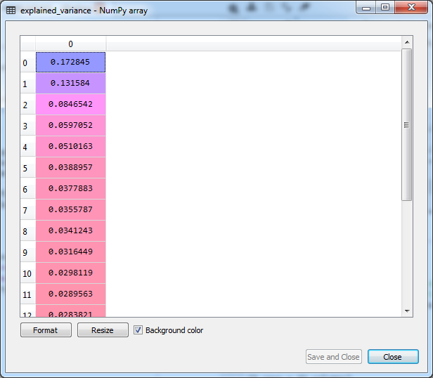

Slide 30
CLASSIFICATION
The Supervised classification algorithm such as Support vector machine, Decision tree, Logistic Regression is used, Unsupervised learning such as K-Nearest Neighbour in Data Mining
Random forests or random decision forests are an ensemble learning method for classification, regression and other tasks that operate by constructing a multitude of decision trees at training time and outputting the class that is the mode of the classes (classification) or mean/average prediction (regression) of the individual trees.
K nearest neighbours is a simple algorithm that stores all available cases and classifies new cases based on a similarity measure (e.g., distance functions). KNN has been used in statistical estimation and pattern recognition and non-parametric technique.

Slide 31
PREDICTION
It’s a process of predicting phishing website attack from the dataset.
This project will effectively predict the data from dataset by enhancing the performance of the overall prediction results.

Slide 32
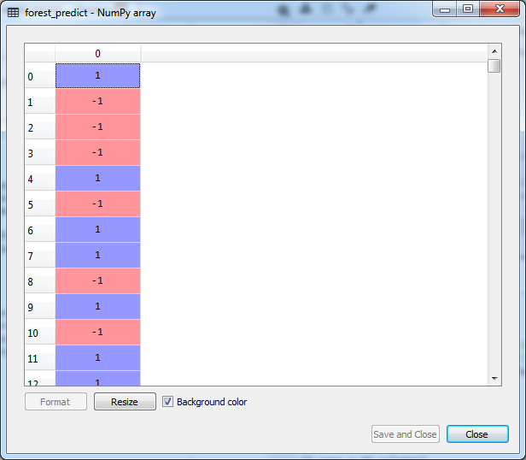
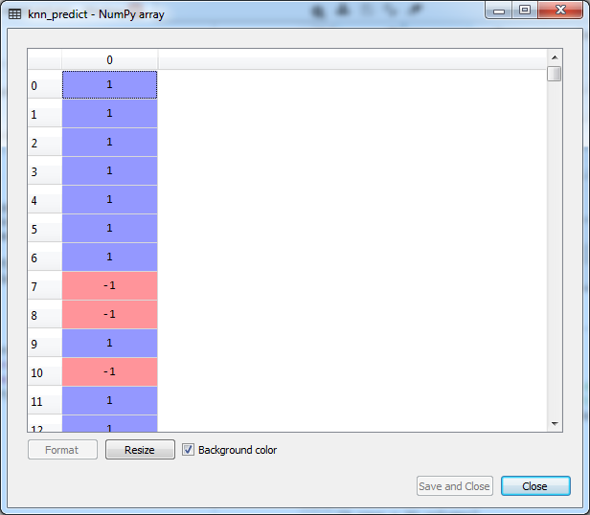

Slide 33
RESULT GENERATION
The Final Result will get generated based on the overall classification and prediction. The performance of this proposed approach is evaluated using some measures like,
Accuracy
Graph based on prediction

Slide 34
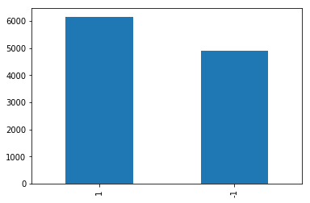

Slide 35
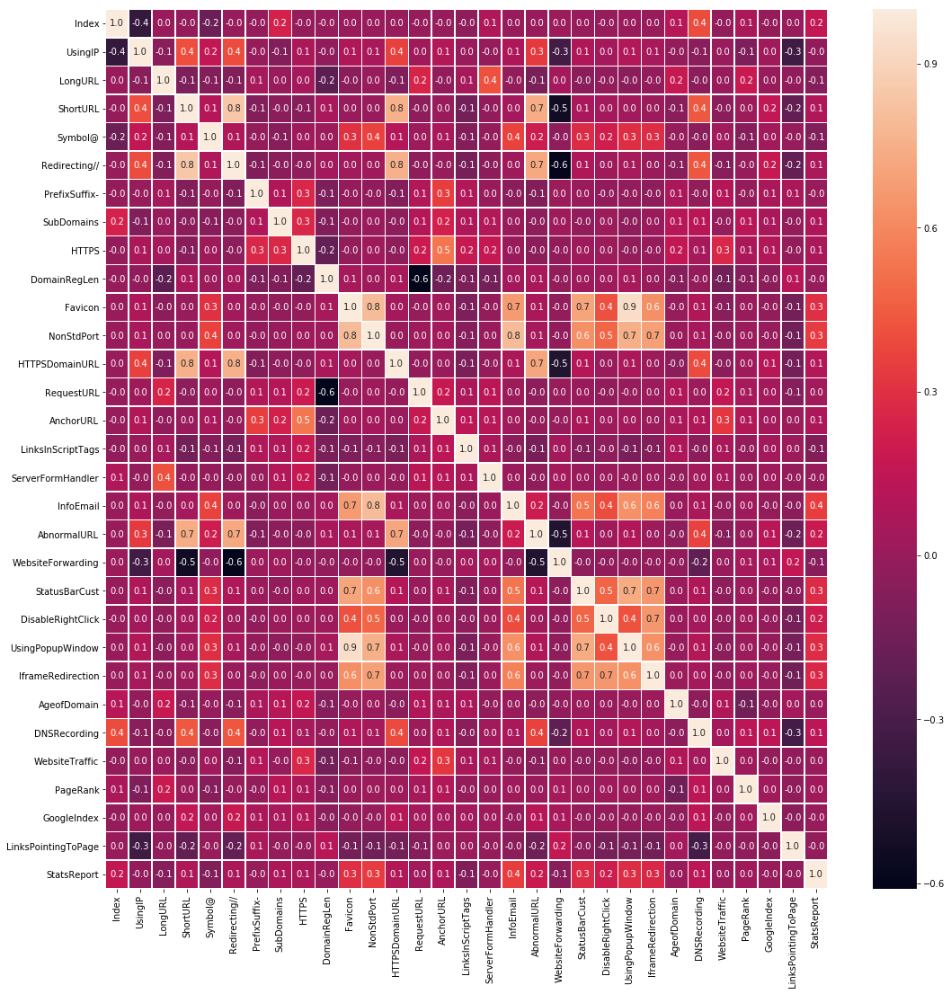

Slide 36
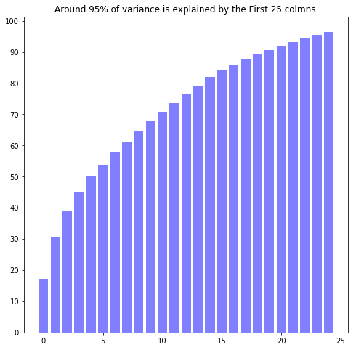

Slide 37
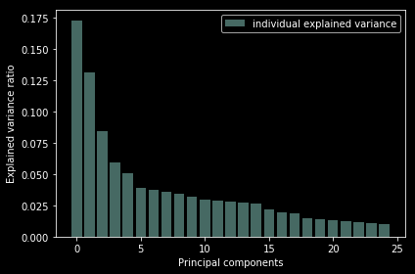
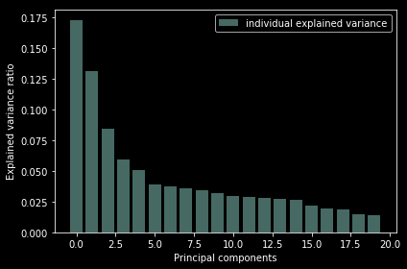

Slide 38
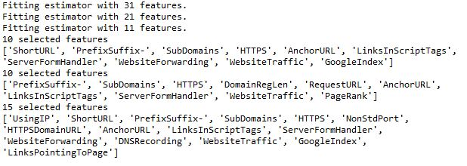

Slide 39
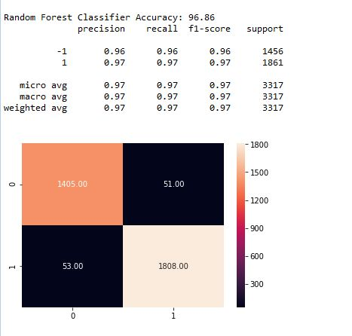
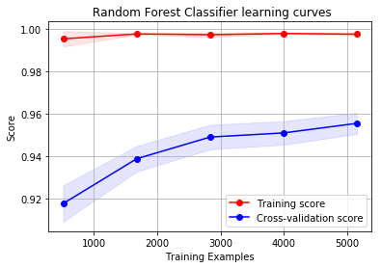

Slide 40
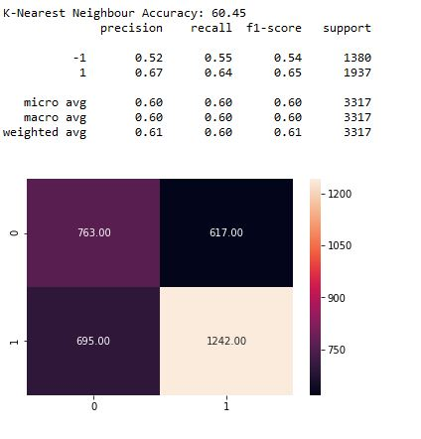
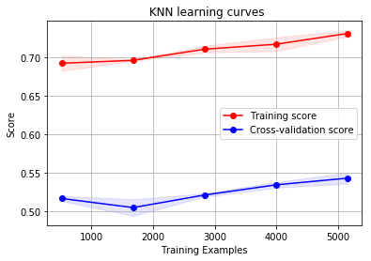

Slide 41
CONCLUSION
This project Evaluate the performance of the classification and prediction.
It finds the different classification performance and it’s summary effectively and quickly.
It alleviate the sparsity problem and reduces the information loss.
The accuracy of the classification result is highly increased.

Slide 42
FUTURE WORK
In future, we will implement this process in different platforms.
Data mining is one of the most widely used methods to extract data from different sources and organize them for better usage. In spite of having different commercial systems for data mining, a lot of challenges come up when they are actually implemented. With rapid evolution in the field of data mining, companies are expected to stay abreast with all the new developments.

Slide 43
REFERENCES
FBI, “Ic3 annual report released.”
APWG, “Phishing activity trends report.”
V. B. et al, “study on phishing attacks,” International Journal of Computer Applications, 2018.
I.-F. Lam, W.-C. Xiao, S.-C. Wang, and K.-T. Chen, “Counteracting phishing page polymorphism: An image layout analysis approach,” in International Conference on Information Security and Assurance, pp. 270–279, Springer, 2009.
W. Jing, “Covert redirect vulnerability,” 2017.
K. Krombholz, H. Hobel, M. Huber, and E. Weippl, “Advanced social engineering attacks,” Journal of Information Security and applications, vol. 22, pp. 113–122, 2015.
P. Kumaraguru, J. Cranshaw, A. Acquisti, L. Cranor, J. Hong, M. A. Blair, and T. Pham, “School of phish: a real-world evaluation of anti-phishing training,” in Proceedings of the 5th Symposium on Usable Privacy and Security, pp. 1–12, 2009.

Slide 44
T. Hastie, S. Rosset, J. Zhu, and H. Zou, “Multi-class adaboost,” Statistics and its Interface, vol. 2, no. 3, pp. 349–360, 2009.
J. H. Friedman, “Stochastic gradient boosting,” Computational statistics & data analysis, vol. 38, no. 4, pp. 367–378, 2002.
T. Chen and C. Guestrin, “Xgboost: A scalable tree boosting system,” in Proceedings of the 22nd acm sigkdd international conference on knowledge discovery and data mining, pp. 785–794, 2016. I. Goodfellow, Y. Bengio, and A. Courville, Deep learning. MIT press, 2016.
R. M. Mohammad, F. Thabtah, and L. McCluskey, “Phishing websites features,” School of Computing and Engineering, University of Huddersfield, 2015.

Slide 45
Thank You..!

